Slide 1
Backpropagation

Slide 2
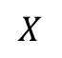

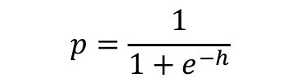
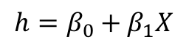
Backpropagation: Logistic Regression Revisited
Affine
Activation
Loss Fun
$$ℒ(β)=\sum_{i}^{n}{ℒ_{i}\left(β\right)}$$
$$p=\frac{1}{1+e^{−h}}$$
$$X$$
$$h=β_{0}+β_{1}X$$

Slide 3
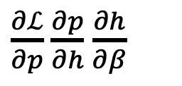
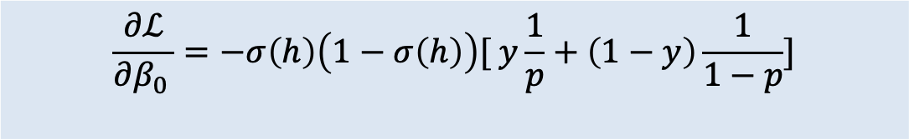
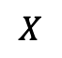
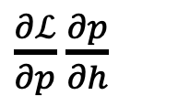
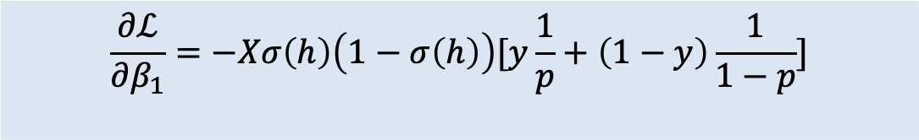
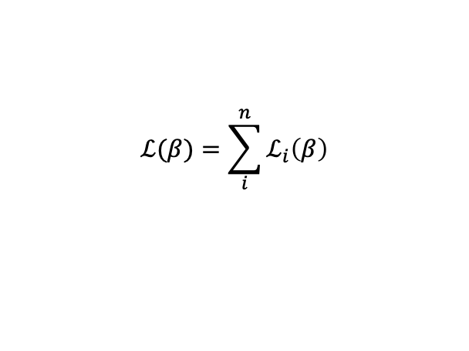
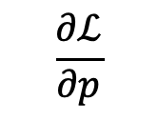
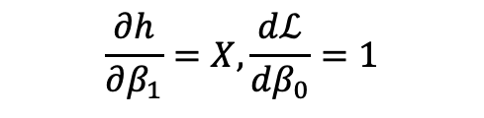
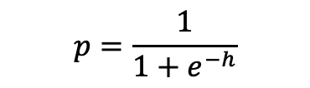
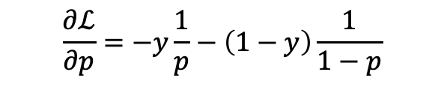
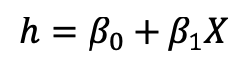
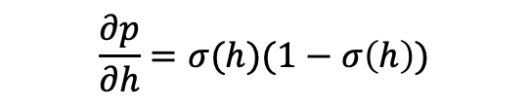
Backpropagation: Logistic Regression Revisited
Affine
Activation
Loss Fun
$$ℒ(β)=\sum_{i}^{n}{ℒ_{i}\left(β\right)}$$
$$p=\frac{1}{1+e^{−h}}$$
$$X$$
$$h=β_{0}+β_{1}X$$
$\frac{∂ℒ}{∂p}$ $\frac{∂p}{∂h}$ $\frac{∂h}{∂β}$
$\frac{∂ℒ}{∂p}$ $\frac{∂p}{∂h}$
$$\frac{∂ℒ}{∂p}$$
$$\frac{∂h}{∂β_{1}}=X,\frac{dℒ}{dβ_{0}}=1$$
$$\frac{∂p}{∂h}=σ(h)(1−σ\left(h\right))$$
$$\frac{∂ℒ}{∂p}=−y\frac{1}{p}−\left(1−y\right)\frac{1}{1−p}$$
$$\frac{∂ℒ}{∂β_{1}}=−Xσ\left(h\right)\left(1−σ\left(h\right)\right)[y\frac{1}{p}+\left(1−y\right)\frac{1}{1−p}]$$
$$\frac{∂ℒ}{∂β_{0 }}=−σ\left(h\right)\left(1−σ\left(h\right)\right)[ y\frac{1}{p}+\left(1−y\right)\frac{1}{1−p}]$$

Slide 4
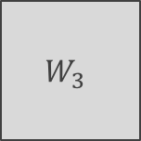
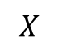
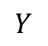
Backpropagation
Derivatives need to be evaluated at some values of X, y, and W.
But since we have an expression, we can build a function that takes as input X, y, W, and returns the derivatives, and then we can use gradient descent to update.
This approach works well but it does not generalize. For example if the network is changed, we need to write a new function to evaluate the derivatives.
For example, this network will need a different function for the derivatives
W₁
$$W_{3}$$
$$X$$
$$Y$$
W₂

Slide 5

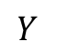

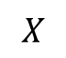

Backpropagation
Derivatives need to be evaluated at some values of X, y, and W.
But since we have an expression, we can build a function that takes as input X, y, W, and returns the derivatives, and then we can use gradient descent to update.
This approach works well but it does not generalize. For example if the network is changed, we need to write a new function to evaluate the derivatives.
For example, this network will need a different function for the derivatives
W₁
$$W_{3}$$
$$W_{5}$$
$$X$$
$$Y$$
W₂
$$W_{4}$$

Slide 6
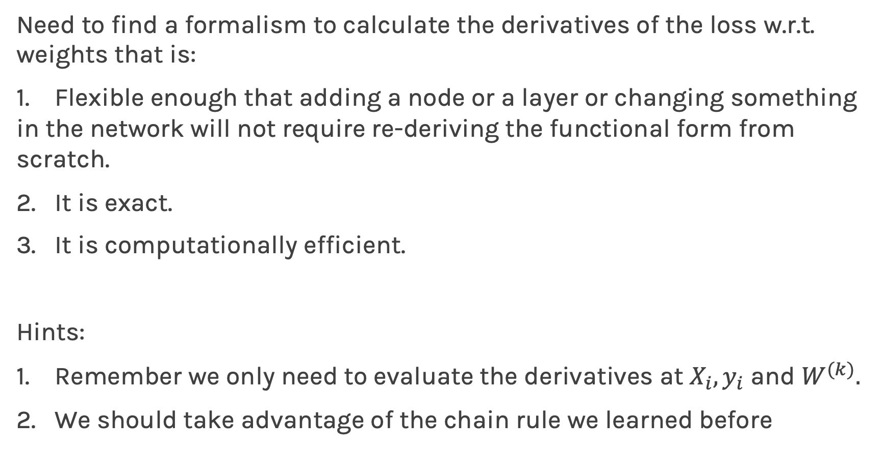
Backpropagation. Pavlos game #456
Need to find a formalism to calculate the derivatives of the loss w.r.t. weights that is:
Flexible enough that adding a node or a layer or changing something in the network will not require re-deriving the functional form from scratch.
It is exact.
It is computationally efficient.
Hints:
Remember we only need to evaluate the derivatives at $X_{i}, y_{i}$ and $W^{(k)}.$
We should take advantage of the chain rule we learned before

Slide 7
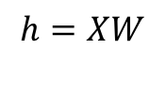
Idea 1: Evaluate the derivative at: X={3}, y=1, W=3
Variables | derivatives | Value of the variable | Value of the partial derivative | $$\frac{dξ_{n}}{dW}$$
$$ξ_{1}=−W^{T}X$$ | $$\frac{∂ξ_{1}}{∂W}=−X$$ | $$−9$$ | -3 | -3
$$ξ_{2}={e^{ξ_{1}}=e}^{−W^{T}X}$$ | $$\frac{∂ξ_{2}}{∂ξ_{1}}=e^{ξ_{1}}$$ | $$e^{−9}$$ | $$e^{−9}$$ | -3$e^{−9}$
$$ξ_{3}=1+ξ_{2}=1+e^{−W^{T}X}$$ | $$\frac{∂ξ_{3}}{∂ξ_{2}}=1$$ | 1+$e^{−9}$ | 1 | -3$e^{−9}$
$$ξ_{4}=\frac{1}{ξ_{3}}=\frac{1}{1+e^{−W^{T}X}}=p$$ | $$\frac{∂ξ_{4}}{∂ξ_{3}}=−\frac{1}{ξ_{3}^{2}}$$ | $$\frac{1}{1+e^{−9}}$$ | $${\left(\frac{1}{1+e^{−9}}\right)}^{2}$$ | -3$e^{−9}{\left(\frac{1}{1+e^{−9}}\right)}^{2}$
$$ξ_{5}=\log{ξ_{4}=\log{p =}\log{\frac{1}{1+e^{−W^{T}X}}}}$$ | $$\frac{∂ξ_{5}}{∂ξ_{4}}=\frac{1}{ξ_{4}}$$ | $$\log{\frac{1}{1+e^{−9}}}$$ | $$1+e^{−9}$$ | -3$e^{−9}{\left(\frac{1}{1+e^{−9}}\right)}^{}$
$$ℒ_{i}^{A}=−yξ_{5}$$ | $$\frac{∂ℒ}{∂ξ_{5}}=−y$$ | $$−\log{\frac{1}{1+e^{−9}}}$$ | $$−1$$ | 3$e^{−9}{\left(\frac{1}{1+e^{−9}}\right)}^{}$
$$\frac{∂ℒ_{i}^{A}}{∂W}=\frac{∂ℒ_{i}}{∂ξ_{5}}\frac{∂ξ_{5}}{∂ξ_{4}}\frac{∂ξ_{4}}{∂ξ_{3}}\frac{∂ξ_{3}}{∂ξ_{2}}\frac{∂ξ_{2}}{∂ξ_{1}}\frac{∂ξ_{1}}{∂W}$$ |  |  | $$−3$$ | 0.00037018372

Slide 8

Basic functions
We still need to derive derivatives ☹
Variables | derivatives | Value of the variable | Value of the partial derivative | $$\frac{dξ_{n}}{dW}$$
$$ξ_{1}=−W^{T}X$$ | $$\frac{∂ξ_{1}}{∂W}=−X$$ | $$−9$$ | -3 | -3
$$ξ_{2}={e^{ξ_{1}}=e}^{−W^{T}X}$$ | $$\frac{∂ξ_{2}}{d∂ξ_{1}}=e^{ξ_{1}}$$ | $$e^{−9}$$ | $$e^{−9}$$ | -3$e^{−9}$
$$ξ_{3}=1+ξ_{2}=1+e^{−W^{T}X}$$ | $$\frac{∂ξ_{3}}{∂ξ_{2}}=1$$ | 1+$e^{−9}$ | 1 | -3$e^{−9}$
$$ξ_{4}=\frac{1}{ξ_{3}}=\frac{1}{1+e^{−W^{T}X}}=p$$ | $$\frac{∂ξ_{4}}{∂ξ_{3}}=−\frac{1}{ξ_{3}^{2}}$$ | $$\frac{1}{1+e^{−9}}$$ | $${\left(\frac{1}{1+e^{−9}}\right)}^{2}$$ | -3$e^{−9}{\left(\frac{1}{1+e^{−9}}\right)}^{2}$
$$ξ_{5}=\log{ξ_{4}=\log{p =}\log{\frac{1}{1+e^{−W^{T}X}}}}$$ | $$\frac{∂ξ_{5}}{∂ξ_{4}}=\frac{1}{ξ_{4}}$$ | $$\log{\frac{1}{1+e^{−9}}}$$ | $$1+e^{−9}$$ | -3$e^{−9}{\left(\frac{1}{1+e^{−9}}\right)}^{}$
$$ℒ_{i}^{A}=−yξ_{5}$$ | $$\frac{∂ℒ}{∂ξ_{5}}=−y$$ | $$−\log{\frac{1}{1+e^{−9}}}$$ | $$−1$$ | 3$e^{−9}{\left(\frac{1}{1+e^{−9}}\right)}^{}$
$$\frac{∂ℒ_{i}^{A}}{∂W}=\frac{∂ℒ_{i}}{∂ξ_{5}}\frac{∂ξ_{5}}{∂ξ_{4}}\frac{∂ξ_{4}}{∂ξ_{3}}\frac{∂ξ_{3}}{∂ξ_{2}}\frac{∂ξ_{2}}{∂ξ_{1}}\frac{∂ξ_{1}}{∂W}$$ |  |  | $$−3$$ | 0.00037018372

Slide 9
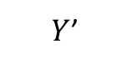
Basic functions
Notice though those are basic functions that my grandparent can do
$$ξ_{0}=X$$ | $$\frac{∂ξ_{0}}{∂X}=1$$ | def x0(x): return X | def derx0(): return 1
$$ξ_{1}=−W^{T}ξ_{0}$$ | $$\frac{∂ξ_{1}}{∂W}=−X$$ | def x1(a,x): return –a*X | def derx1(a,x): return -a
$$ξ_{2}=e^{ξ_{1}}$$ | $$\frac{∂ξ_{2}}{∂ξ_{1}}=e^{ξ_{1}}$$ | def x2(x): return np.exp(x) | def derx2(x): return np.exp(x)
$$ξ_{3}=1+ξ_{2}$$ | $$\frac{∂ξ_{3}}{∂ξ_{2}}=1$$ | def x3(x): return 1+x | def derx3(x): return 1
$$ξ_{4}=\frac{1}{ξ_{3}}$$ | $$\frac{∂ξ_{4}}{∂ξ_{3}}=−\frac{1}{ξ_{3}^{2}}$$ | def der1(x): return 1/(x) | def derx4(x): return -(1/x)**(2)
$$ξ_{5}=\log{ξ_{4}}$$ | $$\frac{∂ξ_{5}}{∂ξ_{4}}=\frac{1}{ξ_{4}}$$ | def der1(x): return np.log(x) | def derx5(x) return 1/x
$$ℒ_{i}^{A}=−yξ_{5}$$ | $$\frac{∂ℒ}{∂ξ_{5}}=−y$$ | def der1(y,x): return –y*x | def derL(y): return -y

Slide 10


Putting it altogether
1. We specify the network structure
W₁
$$W_{3}$$
$$X$$
$$W_{5}$$
$$Y$$
W₂
$$W_{4}$$
2. Following the computational graph …
What is computational graph?

Slide 11
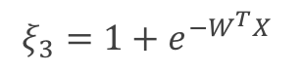
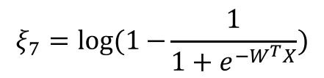





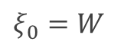

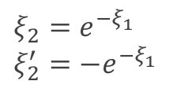
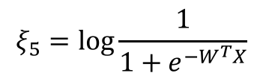
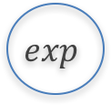
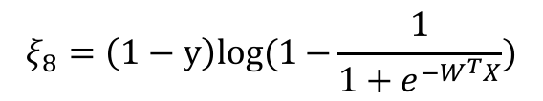
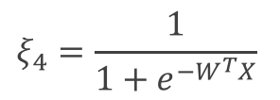
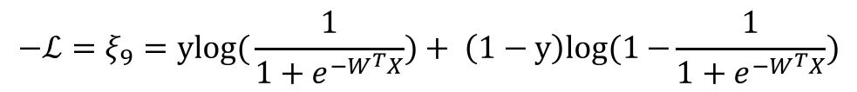
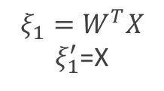
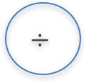

$$ξ_{5}=log{\frac{1}{1+e^{−W^{T}X}}}$$
Computational Graph
$$ξ_{4}=\frac{1}{1+e^{−W^{T}X}}$$
$$÷$$
Log
$$ξ_{7}=log(1−{\frac{1}{1+e^{−W^{T}X}})}$$
$$ξ_{3}={1+e}^{−W^{T}X}$$
$$+$$
log
-
1
$$exp$$
$$ξ_{6}=1−{\frac{1}{1+e^{−W^{T}X}}}$$
1-y
$$ξ_{2}=e^{−ξ_{1}} \\ ξ_{2}^{′}={−e}^{−ξ_{1}}$$
$$−$$
$$×$$
$$ξ_{1}=W^{T}X$$ $ξ_{1}^{′}$=X
y
$$×$$
$$×$$
$$ξ_{8}=\left(1−y\right)log(1−{\frac{1}{1+e^{−W^{T}X}})}$$
$$ξ_{9}=ylog({\frac{1}{1+e^{−W^{T}X}})}$$
W
X
$$+$$
$$ξ_{0}=W$$
$$−ℒ=ξ_{9}=ylog({\frac{1}{1+e^{−W^{T}X}})}+ \left(1−y\right)log(1−{\frac{1}{1+e^{−W^{T}X}})}$$

Slide 12
Putting it altogether
1. We specify the network structure
W₁
$$W_{3}$$
$$X$$
$$W_{5}$$
$$Y$$
W₂
$$W_{4}$$
Envision the computational graph (only needed for the reverse mode).
At each node of the graph we build two functions: the evaluation of the variable and its partial derivative with respect to the previous variable (as shown in the table 3 slides back)
Now we can either go forward or backward depending on the situation. In general, forward is easier to implement and to understand. The difference is clearer when there are multiple nodes per layer.

Slide 13
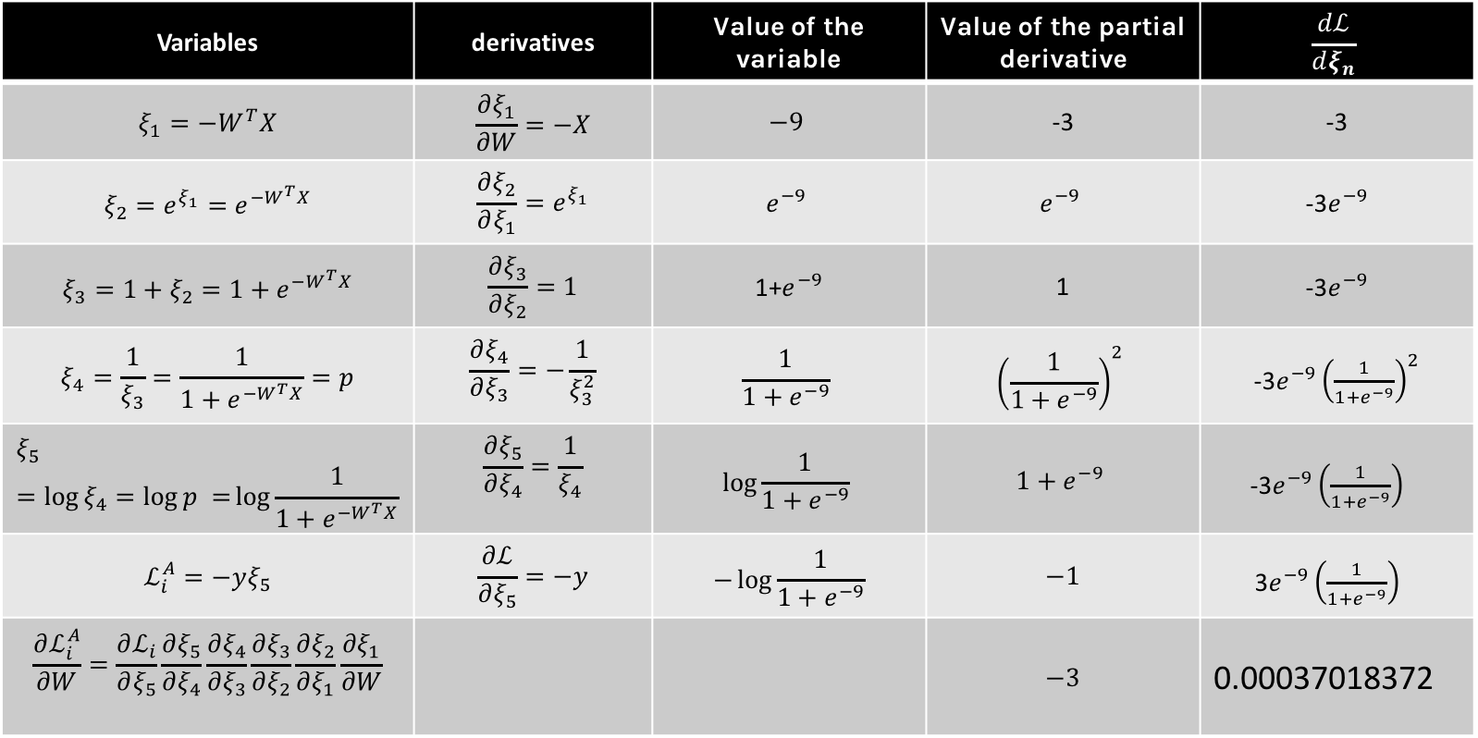
Forward mode: Evaluate the derivative at: X={3}, y=1, W=3
Variables | derivatives | Value of the variable | Value of the partial derivative | $$\frac{dℒ}{dξ_{n}}$$
$$ξ_{1}=−W^{T}X$$ | $$\frac{∂ξ_{1}}{∂W}=−X$$ | $$−9$$ | -3 | -3
$$ξ_{2}={e^{ξ_{1}}=e}^{−W^{T}X}$$ | $$\frac{∂ξ_{2}}{∂ξ_{1}}=e^{ξ_{1}}$$ | $$e^{−9}$$ | $$e^{−9}$$ | -3$e^{−9}$
$$ξ_{3}=1+ξ_{2}=1+e^{−W^{T}X}$$ | $$\frac{∂ξ_{3}}{∂ξ_{2}}=1$$ | 1+$e^{−9}$ | 1 | -3$e^{−9}$
$$ξ_{4}=\frac{1}{ξ_{3}}=\frac{1}{1+e^{−W^{T}X}}=p$$ | $$\frac{∂ξ_{4}}{∂ξ_{3}}=−\frac{1}{ξ_{3}^{2}}$$ | $$\frac{1}{1+e^{−9}}$$ | $${\left(\frac{1}{1+e^{−9}}\right)}^{2}$$ | -3$e^{−9}{\left(\frac{1}{1+e^{−9}}\right)}^{2}$
$$ξ_{5}=\log{ξ_{4}=\log{p =}\log{\frac{1}{1+e^{−W^{T}X}}}}$$ | $$\frac{∂ξ_{5}}{∂ξ_{4}}=\frac{1}{ξ_{4}}$$ | $$\log{\frac{1}{1+e^{−9}}}$$ | $$1+e^{−9}$$ | -3$e^{−9}{\left(\frac{1}{1+e^{−9}}\right)}^{}$
$$ℒ_{i}^{A}=−yξ_{5}$$ | $$\frac{∂ℒ}{∂ξ_{5}}=−y$$ | $$−\log{\frac{1}{1+e^{−9}}}$$ | $$−1$$ | 3$e^{−9}{\left(\frac{1}{1+e^{−9}}\right)}^{}$
$$\frac{∂ℒ_{i}^{A}}{∂W}=\frac{∂ℒ_{i}}{∂ξ_{5}}\frac{∂ξ_{5}}{∂ξ_{4}}\frac{∂ξ_{4}}{∂ξ_{3}}\frac{∂ξ_{3}}{∂ξ_{2}}\frac{∂ξ_{2}}{∂ξ_{1}}\frac{∂ξ_{1}}{∂W}$$ |  |  | $$−3$$ | 0.00037018372

Slide 14
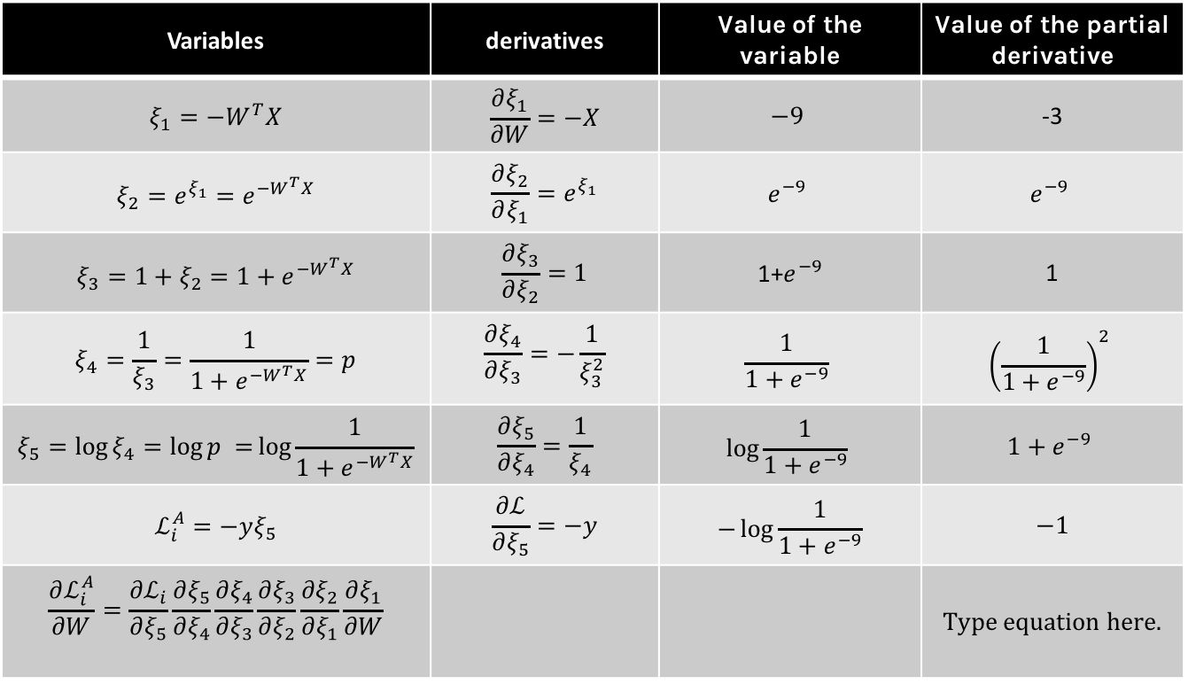
Backward mode: Evaluate the derivative at: X={3}, y=1, W=3
Variables | derivatives | Value of the variable | Value of the partial derivative
$$ξ_{1}=−W^{T}X$$ | $$\frac{∂ξ_{1}}{∂W}=−X$$ | $$−9$$ | -3
$$ξ_{2}={e^{ξ_{1}}=e}^{−W^{T}X}$$ | $$\frac{∂ξ_{2}}{∂ξ_{1}}=e^{ξ_{1}}$$ | $$e^{−9}$$ | $$e^{−9}$$
$$ξ_{3}=1+ξ_{2}=1+e^{−W^{T}X}$$ | $$\frac{∂ξ_{3}}{∂ξ_{2}}=1$$ | 1+$e^{−9}$ | 1
$$ξ_{4}=\frac{1}{ξ_{3}}=\frac{1}{1+e^{−W^{T}X}}=p$$ | $$\frac{∂ξ_{4}}{∂ξ_{3}}=−\frac{1}{ξ_{3}^{2}}$$ | $$\frac{1}{1+e^{−9}}$$ | $${\left(\frac{1}{1+e^{−9}}\right)}^{2}$$
$$ξ_{5}=\log{ξ_{4}=\log{p =}\log{\frac{1}{1+e^{−W^{T}X}}}}$$ | $$\frac{∂ξ_{5}}{∂ξ_{4}}=\frac{1}{ξ_{4}}$$ | $$\log{\frac{1}{1+e^{−9}}}$$ | $$1+e^{−9}$$
$$ℒ_{i}^{A}=−yξ_{5}$$ | $$\frac{∂ℒ}{∂ξ_{5}}=−y$$ | $$−\log{\frac{1}{1+e^{−9}}}$$ | $$−1$$
$$\frac{∂ℒ_{i}^{A}}{∂W}=\frac{∂ℒ_{i}}{∂ξ_{5}}\frac{∂ξ_{5}}{∂ξ_{4}}\frac{∂ξ_{4}}{∂ξ_{3}}\frac{∂ξ_{3}}{∂ξ_{2}}\frac{∂ξ_{2}}{∂ξ_{1}}\frac{∂ξ_{1}}{∂W}$$
Store all these values

Slide 15
Check this: https://autoed.herokuapp.com

Slide 17
I suggest to use pen and paper to calculate the derivatives Back-propagation by hand

